Slide 1
Noise robust speech recognition using feature compensation based on polynomial regression of utterance SNR
Author : Xiaodong Cui and Abeer Alwan
Professor : 陳嘉平
Reporter : 楊治鏞

Slide 2
Outline
Introduction
Polynomial regression of SNR
Utterance SNR estimation
Experimental result

Slide 3
Introduction
In this paper, feature compensation based on polynomial regression of the utterance signal-to-noise ratio (SNR) is investigated.
The bias between the clean and noisy speech features in the cepstral domain is approximated by a set of polynomials with respect to utterance SNR.

Slide 4
Polynomial regression of SNR
Bias approximation by SNR
Feature compensation
ML estimation of regression polynomials

Slide 5
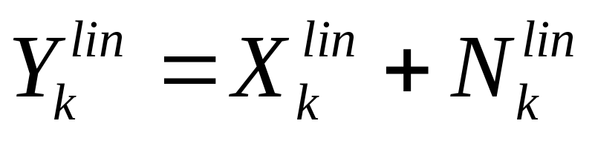
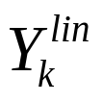
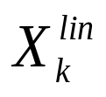


Bias approximation by SNR (1/4)
Where , and denote noisy speech, clean speech and noise in the linear power domain of the th filter bin respectively.

Slide 6
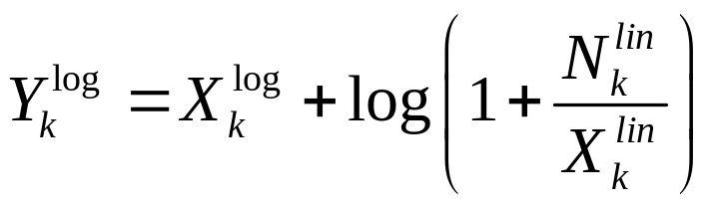
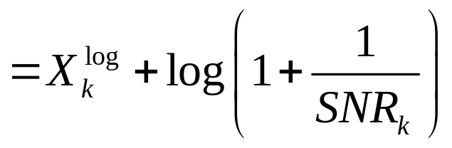
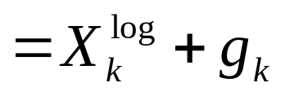
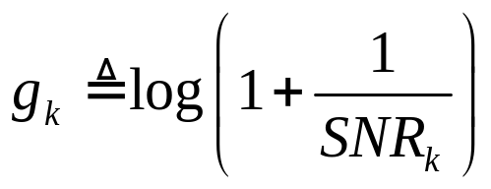
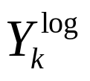
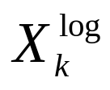
Bias approximation by SNR (2/4)
Where and represent noisy and clean speech in the log-power domain.

Slide 7

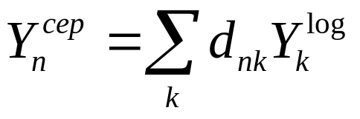
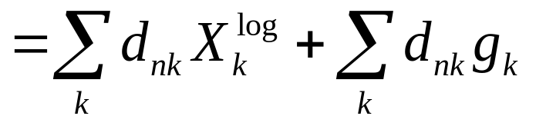
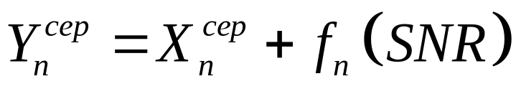




Bias approximation by SNR (3/4)
DCT
We get the th cepstral coefficient as
Where and are the th cepstral component of noisy and clean speech , ’s are the DCT coefficients and denotes a function of SNR of the th cepstral coefficient.

Slide 8
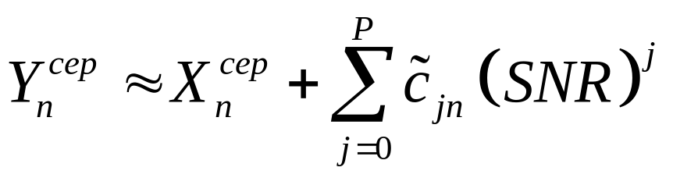
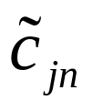


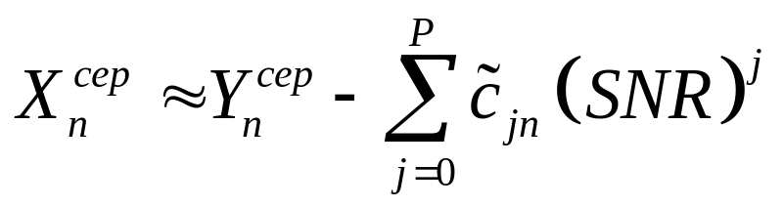
Bias approximation by SNR (4/4)
Where ’s are the coefficients for the th order item of the th cepstrum.

Slide 9

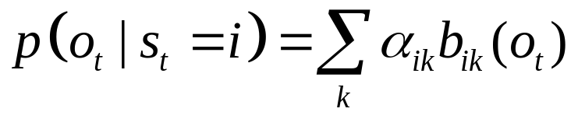





Feature compensation (1/2)
Assuming that the clean acoustic models are Gaussian mixture HMMs, the probability density function of observing feature from state is computed as
Where is the th multivariate Gaussian mixture in state with weight and and
are the mean vector and covariance matrix associated with it, respectively.

Slide 10
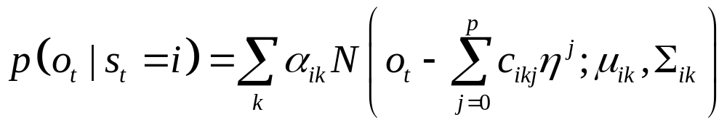








Feature compensation (2/2)
is the noisy speech feature, and are the mean and covariance of Gaussian mixtures in clean acoustic HMMs. is the utterance SNR. ’s are the coefficients of the regression polynomials of state , mixture and polynomial order .

Slide 11
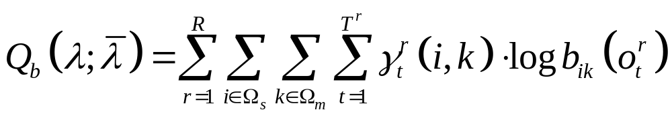









ML estimation of regression polynomials
Where is the utterance number of adaptation data and
is the frame number of the th utterance. and are the state and mixture sets, respectively. is the posterior probability of staying at state mixture at time given the th observation sequence .

Slide 12


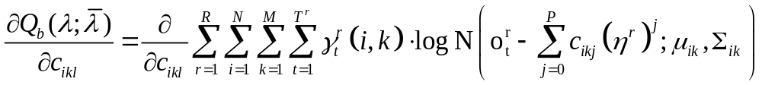
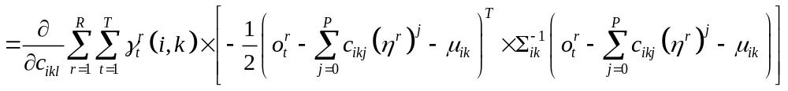
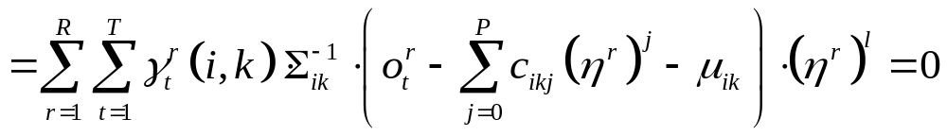

ML estimation of regression polynomials
Optimizing with respect to , one obtains

Slide 13
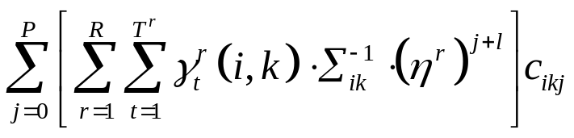
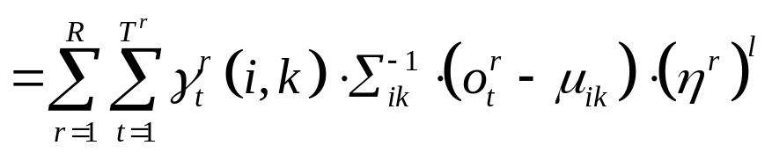
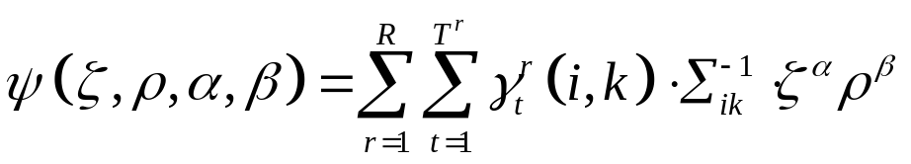
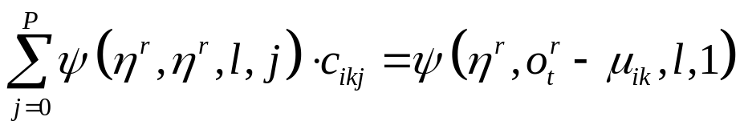
ML estimation of regression polynomials

Slide 14
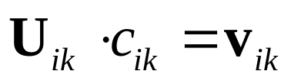
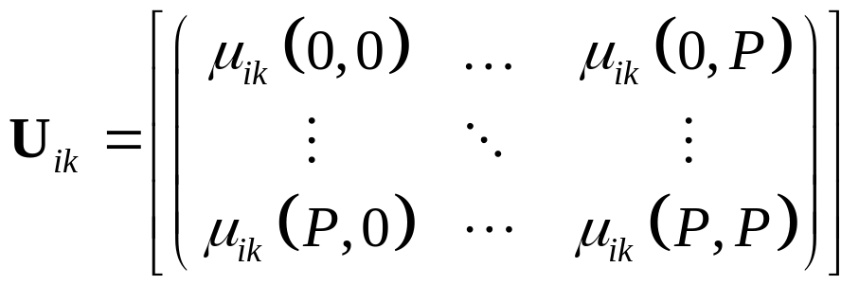
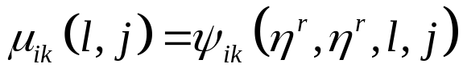
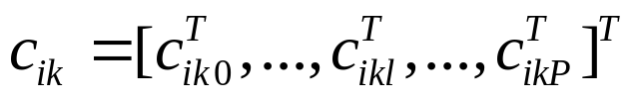

ML estimation of regression polynomials

Slide 15
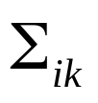

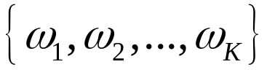
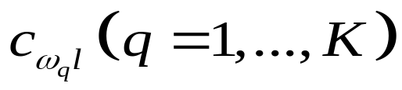
ML estimation of regression polynomials
When the covariance matrices are diagonal (which is usually the case), the computational load could be significantly reduced.
Suppose there are classes within which the regression polynomials of different Gaussian mixtures are shared.

Slide 16
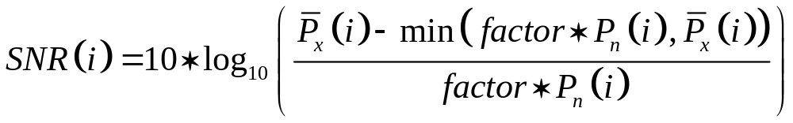
Utterance SNR estimation (1/2)
Minimum statistics tracking algorithm
Power spectral minimum statistics are searched within a 0.5 second interval preceding each speech frame.
Factor 2.0

Slide 17
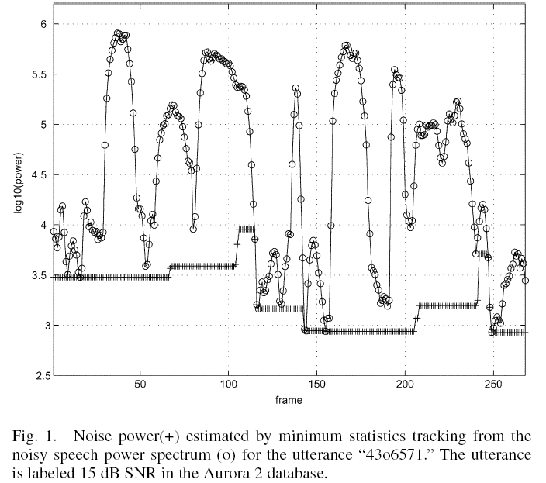

Slide 18
Utterance SNR estimation (2/2)
There is an SNR floor set at 0 dB for all frames since SNR estimates below 0 dB are assumed to be not reliable.
The utterance SNR used in the polynomial regression feature compensation is the average of the nonzero frame SNRs of the utterance.

Slide 19
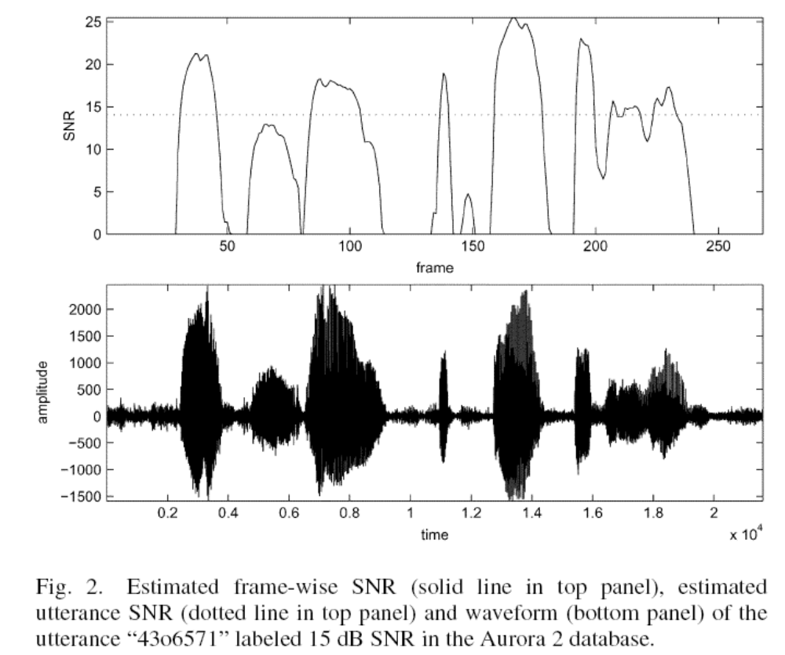

Slide 20
Experimental result
Aurora 2
HMMs
All the Gaussian mixtures have diagonal covariance matrices.

Slide 21
Distribution of utterance SNRs
Fig.4 and Fig.5.
Small variances (2–3 dB) are observed in the estimated utterance SNRs for each condition in those figures.

Slide 22
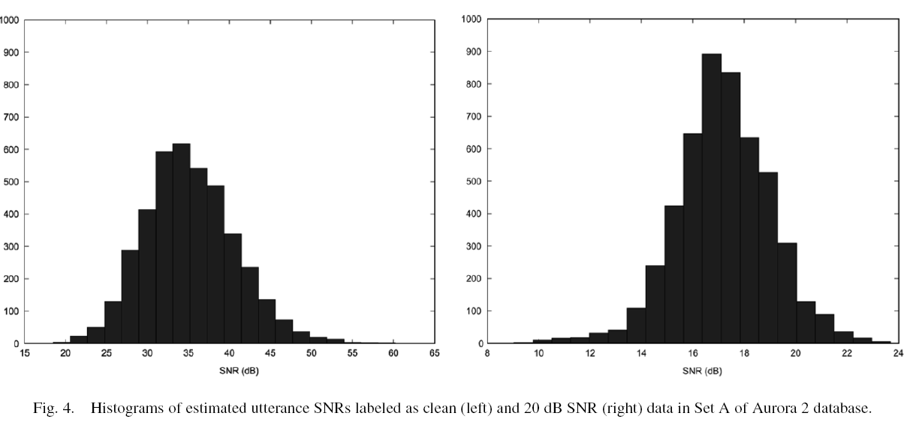

Slide 23
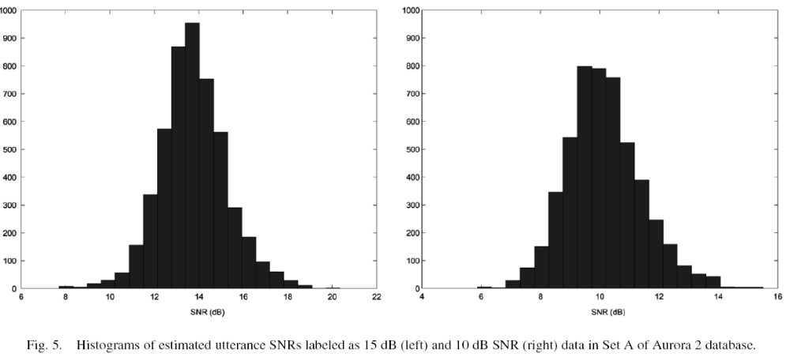

Slide 24
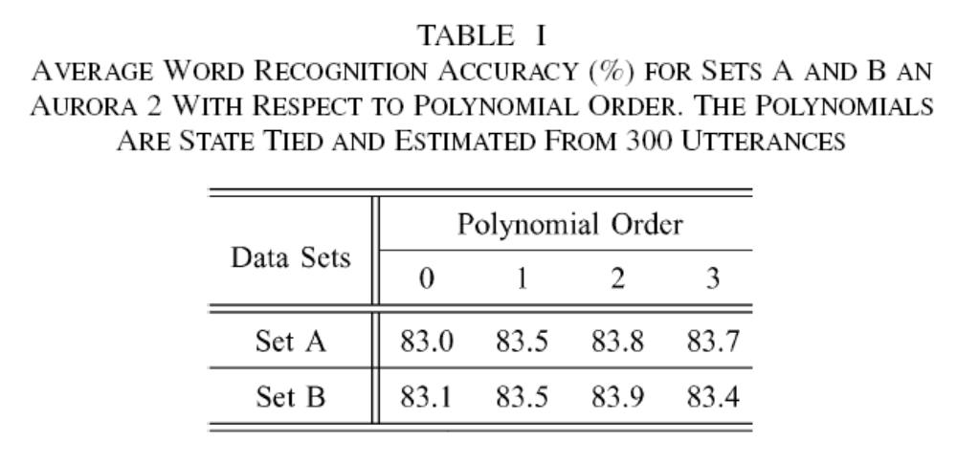
Regression polynomial orders

Slide 25
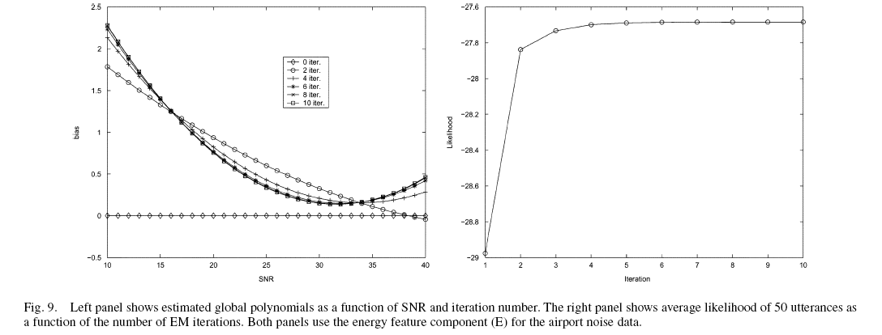
Estimated regression polynomials

Slide 26
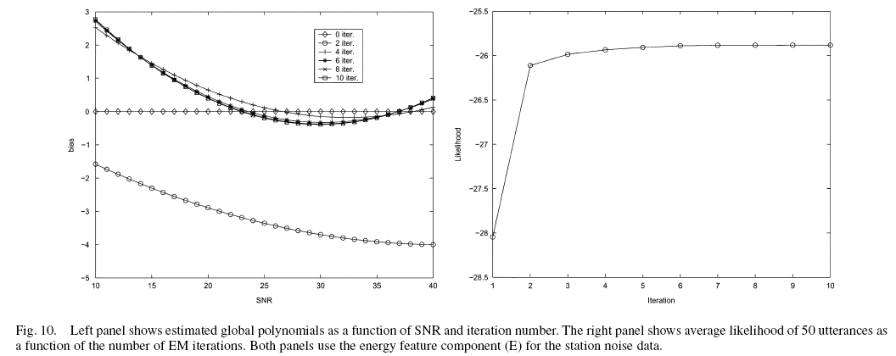
Estimated regression polynomials

Slide 27
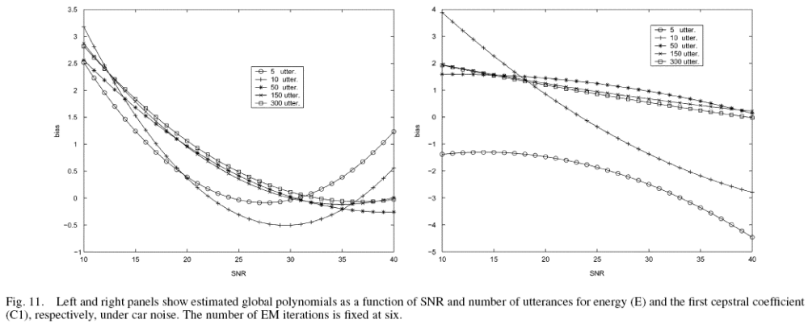
Estimated regression polynomials

Slide 28
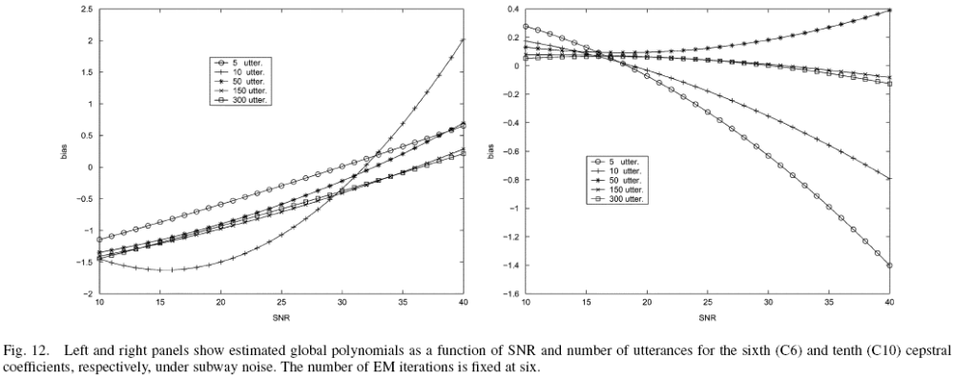
Estimated regression polynomials

Slide 29
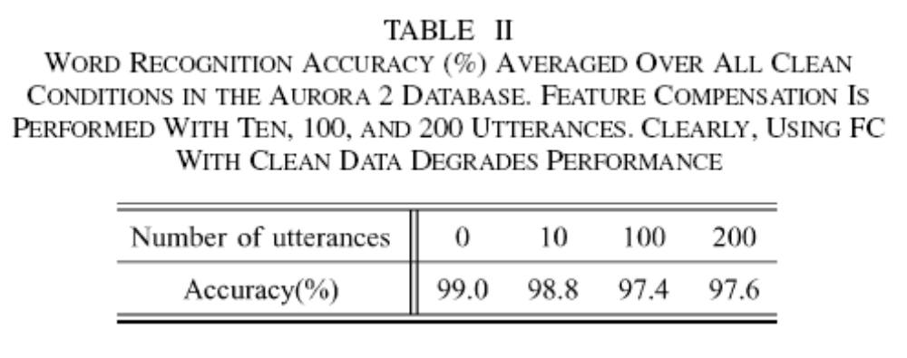
Estimated regression polynomials

Slide 30
Recognition results
5, 10, and 20 utterances, polynomials are tied globally.
50, 100, and 150 utterances, polynomials are tied within states.
200, 250, and 300 utterances, polynomials are Gaussian mixture specific.
The regression polynomial order is set to two.

Slide 31
Recognition results
In the tables, MLLR1 denotes the case where MLLR transformation matrices are estimated by all of the adaptation data and MLLR2 denotes the SNR-cluster specific case.

Slide 32
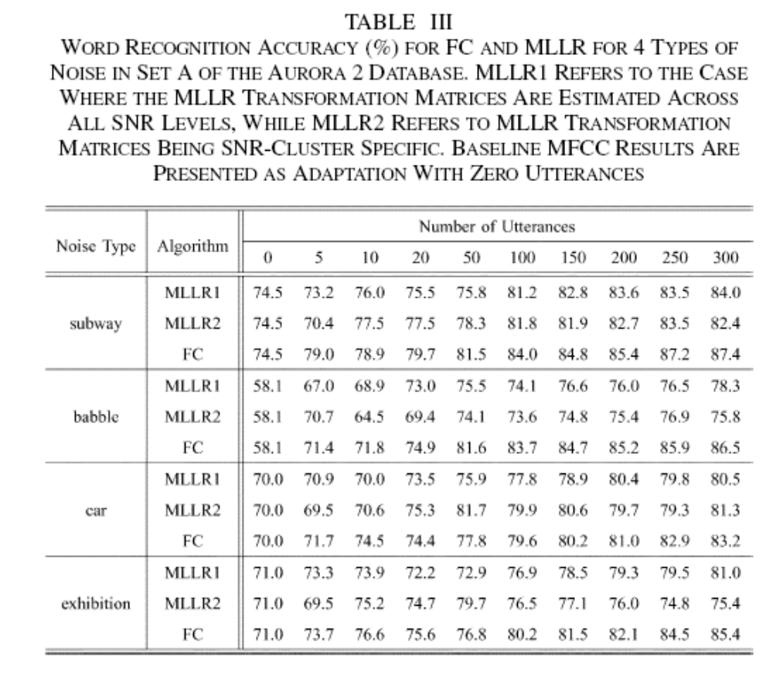

Slide 33
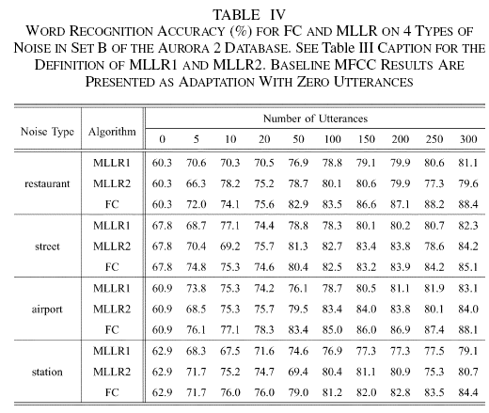

Slide 34
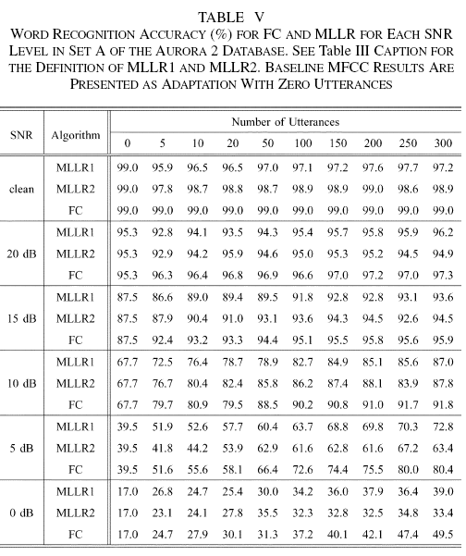

Slide 35
